Slide 1
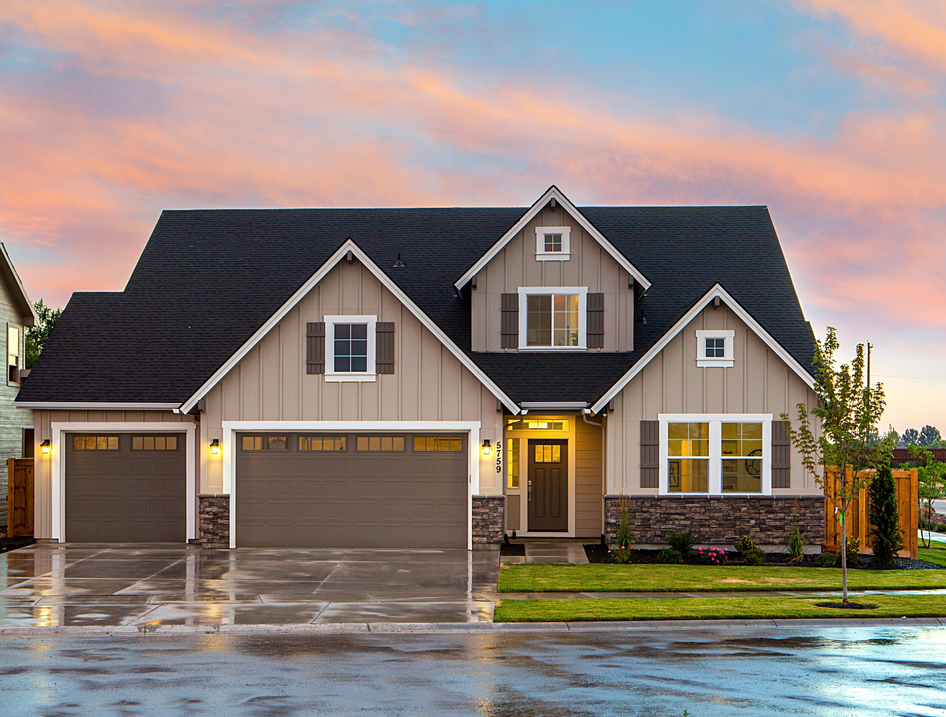
Prediction of Real Estate Prices in Daegu, South Korea
Qiyu Leng / ql2437
Yuhong Wu/ yw3533
Jiani Fan/ jf3443
Emily Ziyi Xiao/ ex2130

Slide 2
Agenda
Introduction
Data Cleaning
Finding Features
Model Selection
Result Comparison

Slide 3
Context & Objective
Urbanization and population growth lead to a rising demand for apartments
The objective of this project is to find out most important features and best prediction model to calculate apartment price
Models Include:
Linear Regression, KNN, Lasso, Ridge, Decision Tree, Random Forest
Introduction

Slide 4
Dataset Description
Contains apartment price in Daegu in South Korea from 2007 to 2017, including 5891 entries and 30 variables
Among the 30 variables, there are 8 integers, 6 objects and 16 floats. Sale Price is the response
Does not contain any missing value
Introduction

Slide 5



Variables
Introduction
Time
Location
Facilities
Age & season
Public Service
Year to build
Year to sold
Month to sold
Hospital
School
Subway
Heating System
Hallway Type
Parking Lot

Slide 6
Data Cleaning
Purpose: Data cleaning & Choose the most significant features
Transferred the categorical value to the numerical value
(e.g. The dataset uses the time taken to the subway and bus stations to represent the distance for residents. We transferred the different period groups to numbers, where the larger numbers mean closer to stops than small numbers.)

Slide 7
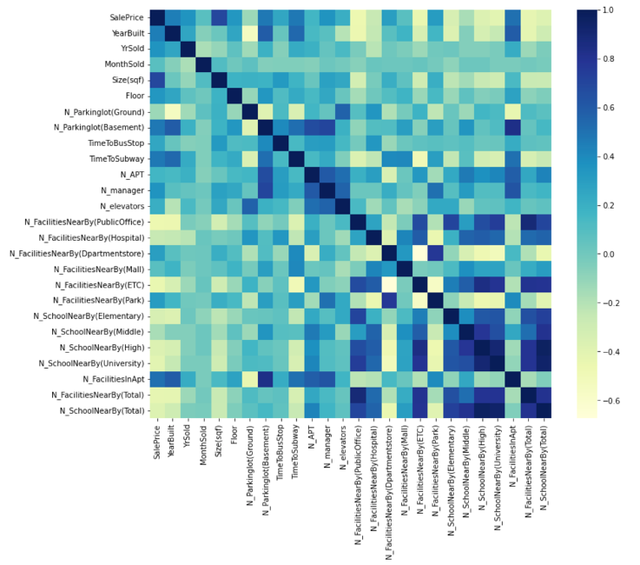
Heat Map
Data Cleaning
The darker the color the closer the correlations.
Correlation = 1 in the diagonal line.
Some close correlations between variables

Slide 8
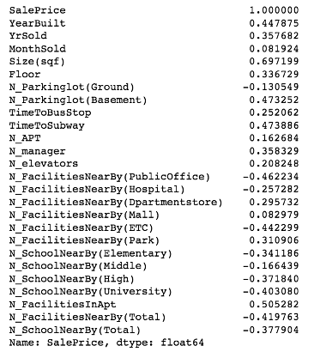
Correlation to Sale Price
The size(sqf), and facilities in the apartment are the two most correlated factors
Almost all of the variables correlate with the price to a similar extent ranging (-0.5,0.5).
Data Cleaning

Slide 9
Steps
Delete the features with word explanations (e.g. hallway, heating, and Apartment management types)
Include the previous transformed numerical distance factors.
Create X and Y in the regression model.
Standardize X
Split the X and Y into train set and test set (30%)
Use linear regression to first fit our model
Data Cleaning

Slide 10
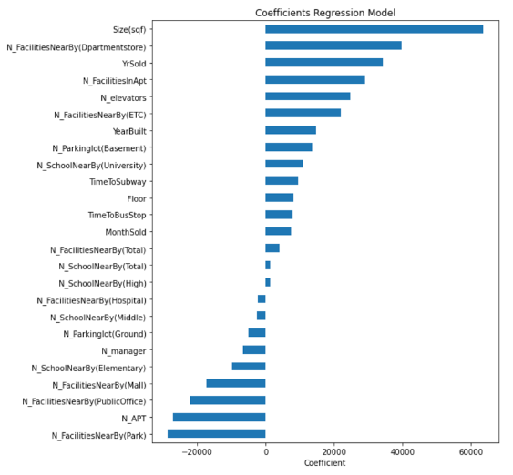
Linear Regression Coefficient
Data Cleaning
Rank from most positively correlated to most negatively correlated factors.
Size, Year of Sold, Facilities
RMSE = 39,277
Might due to outliers

Slide 11
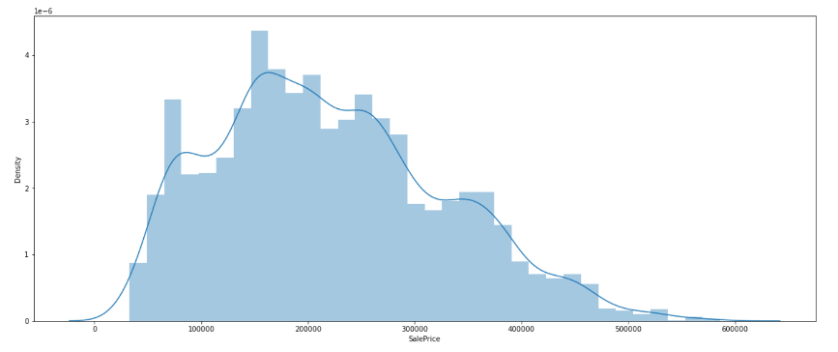
Data Cleaning
Data Outliers
Data is right-skewed
Some sales price extremely high, may influence the result of our model.

Slide 12
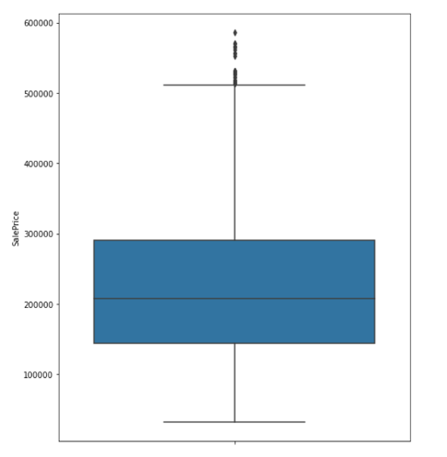
Data Outliers
Figure out which part of y is the outlier number.
Drop the value above 51,000
Refit into the linear regression model.
The RMSE = 38923
Slightly better
Data Cleaning

Slide 13
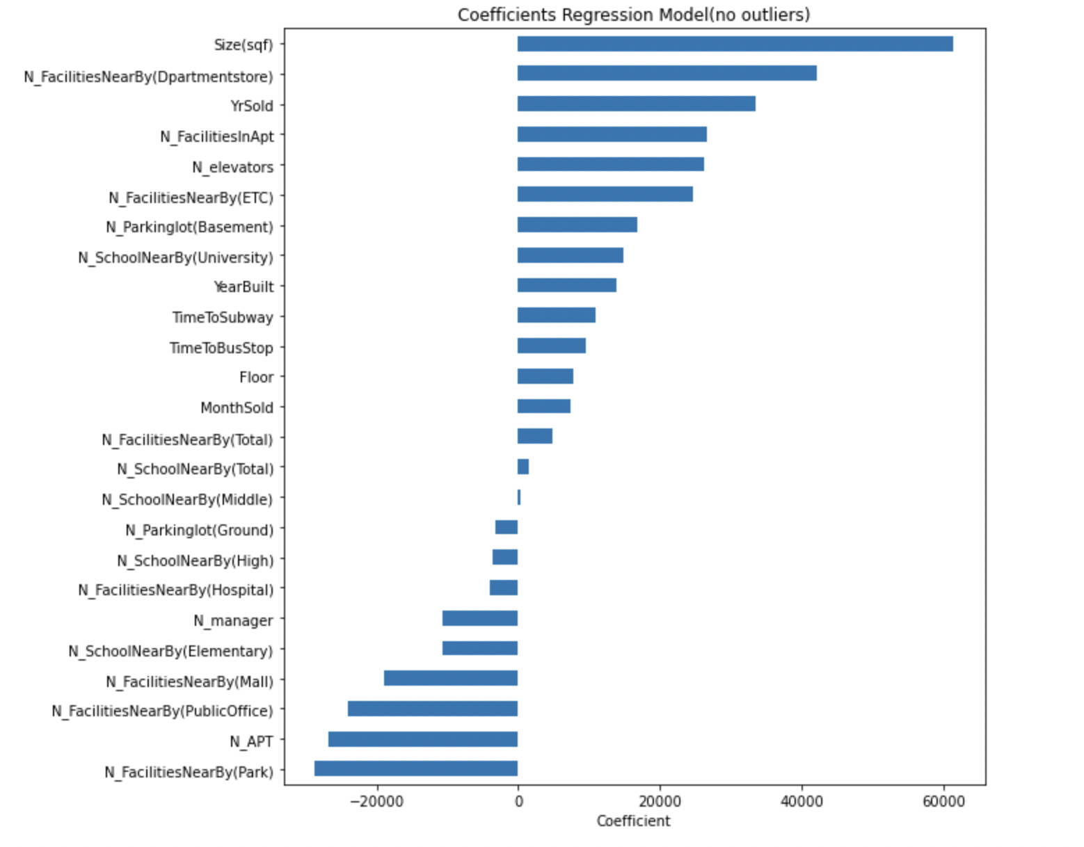
Coefficients of 25 Features
Plot bar chart of 25 features’ coefficients
Six features having low coefficients
Number of elevators and number of parking (basement) having high coefficient
Finding Features

Slide 14
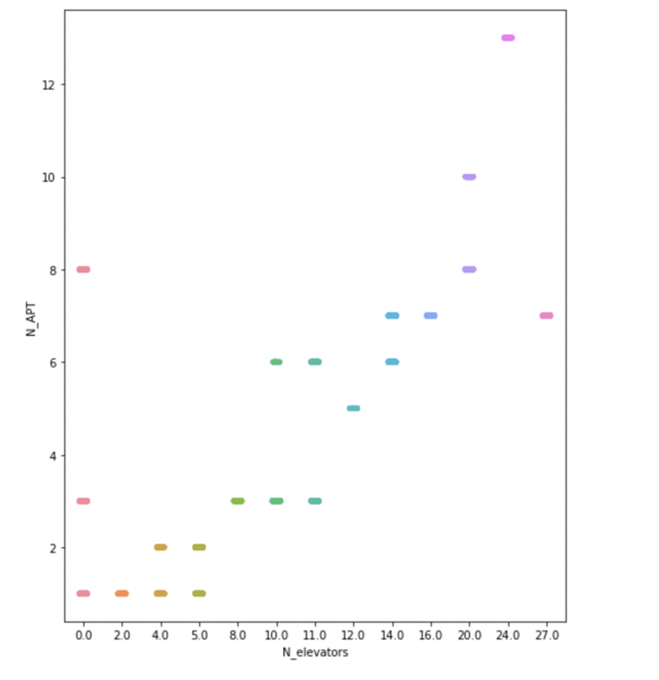
High Correlation
Finding Features
More people stay in apartments, more elevators are needed
Scatter diagram illustrates linear pattern
13–15

Slide 15
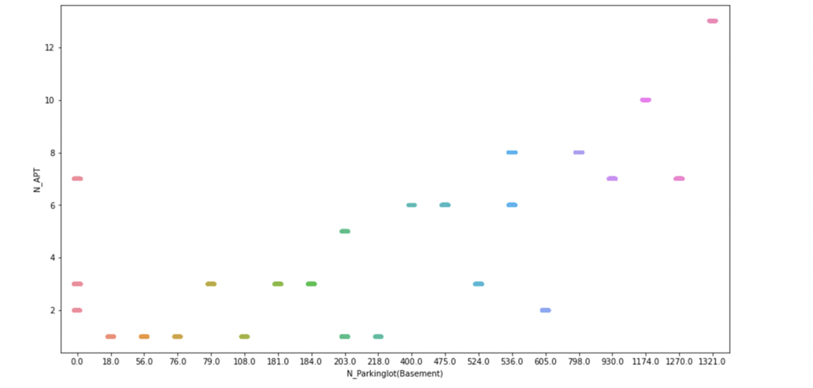
High Correlation
Number of parking spaces and number of apartments have linear relation
Delete number of elevators and number of parking spaces
Finding Features
13–15

Slide 16
Model is even worse!
After deleting eight features, fit the model again
RMSE is even higher than before
Worse result indicates that model cannot predict well with fewer features
RMSE (about 40000) shows us that model cannot predict well
Next step is optimizing it
Finding Features

Slide 17
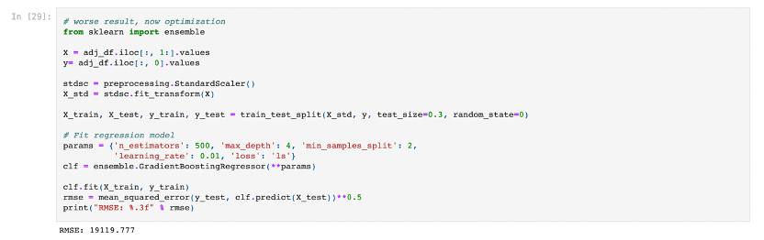
Optimizing
Finding Features
Gradient Boosting Regressor from sklearn
After optimizing the model, its RSME becomes much smaller

Slide 18
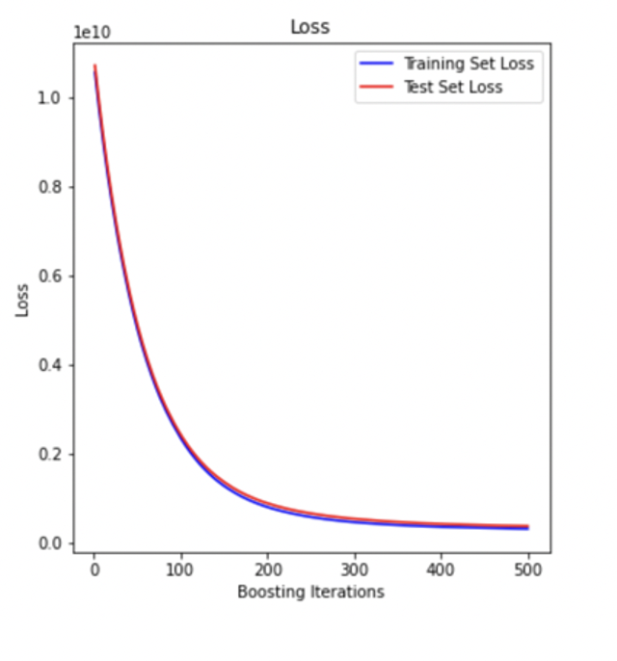
Loss Diagram
Show a downward trend
Model is better after 500 boosting interactions
Finding Features
13–15

Slide 19
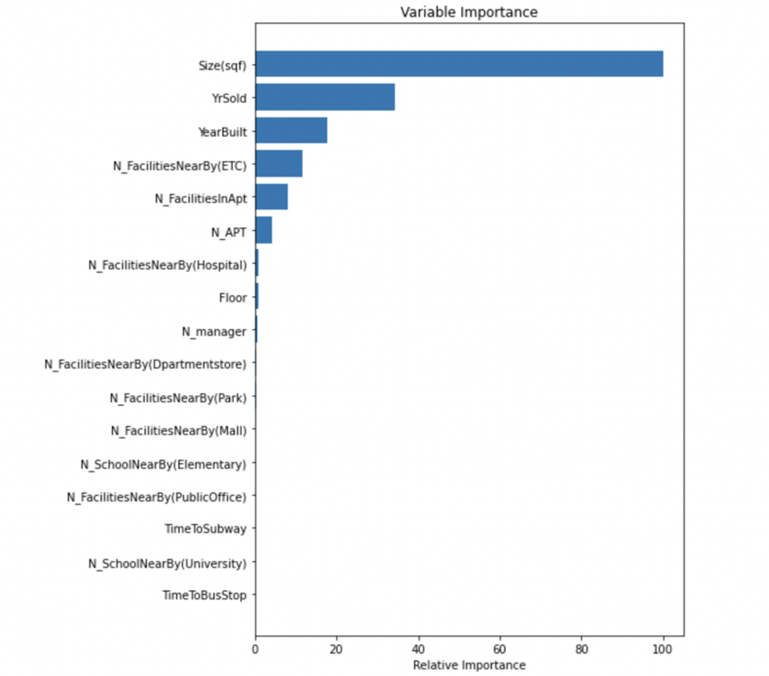
Most Important Features
Finding Features
Plot feature importance by making importance relative to max importance
6 most important features affecting on apartment price

Slide 20
Find the Best Model
Compare six models’ RMSE and R^2 to find the best one
Linear, KNN, Lasso, Ridge, Decision Tree and Random Forest
Model Selection

Slide 21
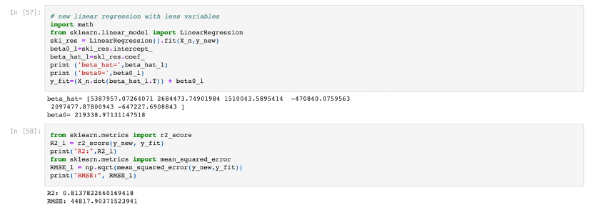
Linear Regression
Model Selections
The whole set of X and y is used to fit the linear regression to calculate RMSE_{fit} and R^2_{fit}.

Slide 22
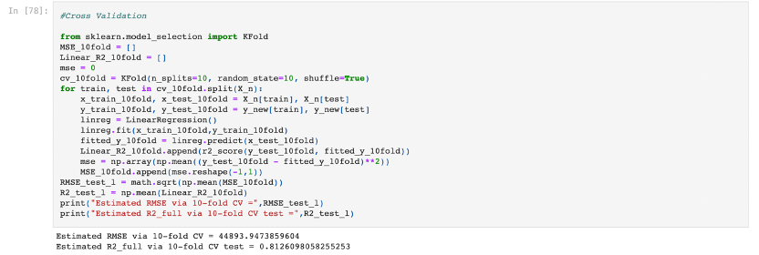
Linear Regression
Model Selections
Then 10-fold cross validation is used to split the whole set of data to training set and test set, followed by working out E(RMSE _{test}) and E(R^2 _{test}).

Slide 23
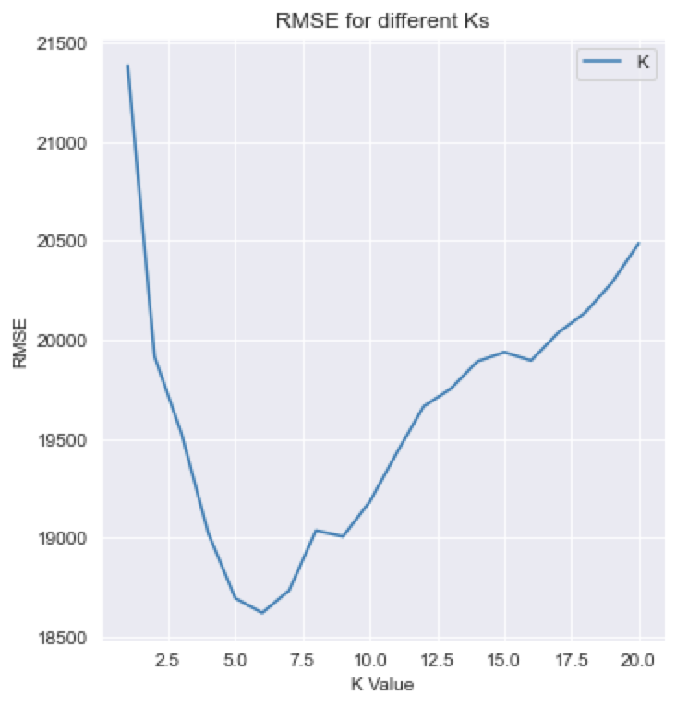
KNN
Best fit: K = 6
RMSE_{fit} = 16851.562676
R^2_{fit}. = 0.973673
E(RMSE _{test}) = 18601.933899
E(R^2 _{test}) = 0.967749
Model Selections
REAL ESTATE LISTING
13–15

Slide 24
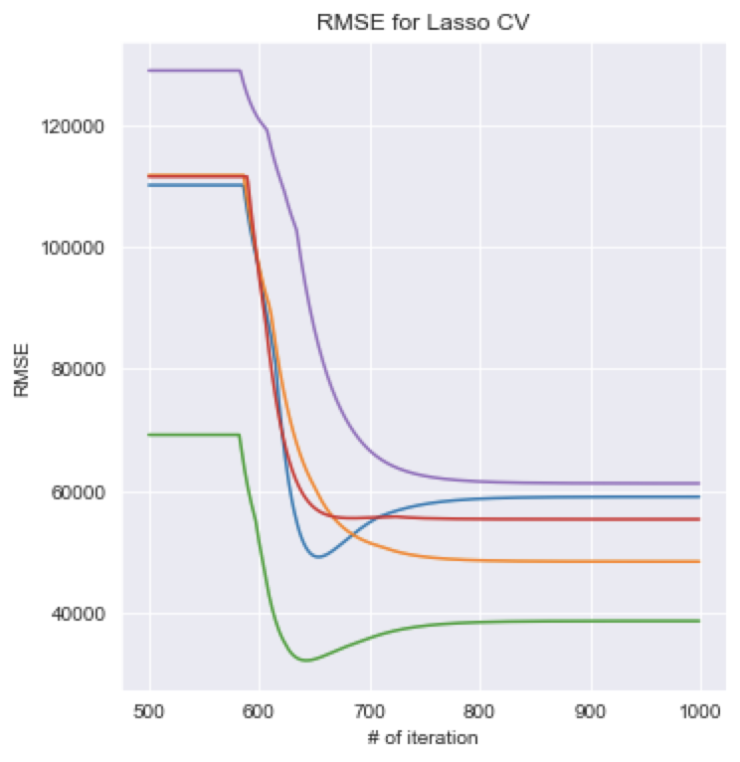
Lasso
Best fit: λ = 1.6114143e-13
RMSE_{fit} = 44817.903715
R^2_{fit}. = 0.813782
E(RMSE _{test}) = 44894.386830
E(R^2 _{test}) = 0.812606
Model Selections
REAL ESTATE LISTING
13–15

Slide 25
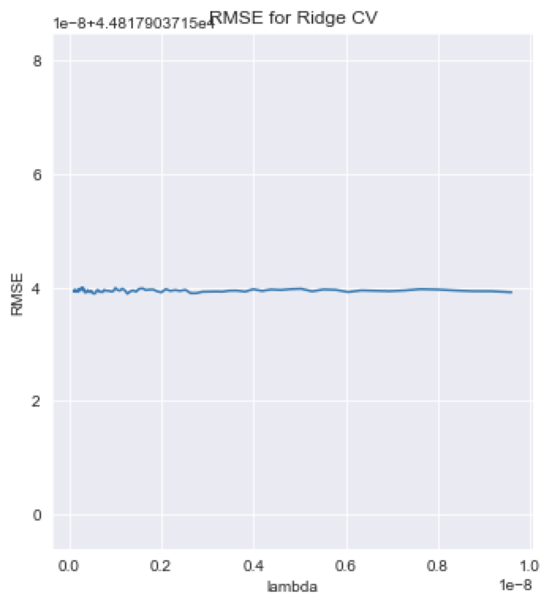
Ridge
Best fit: λ = 0.000671161
RMSE_{fit} = 44817.955586
R^2_{fit}. = 0.813782
E(RMSE _{test}) = 44893.861264
E(R^2 _{test}) = 0.812610
Model Selections
REAL ESTATE LISTING
13–15

Slide 26
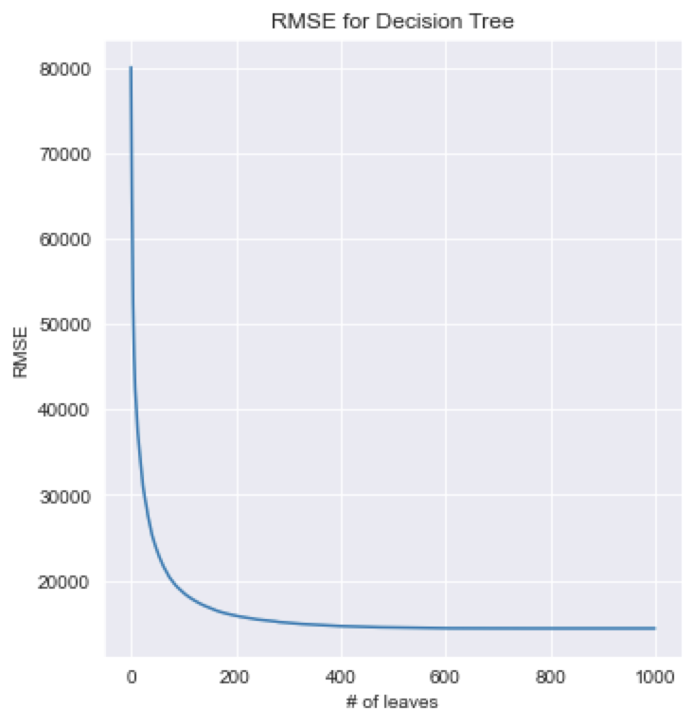
Decision Tree
Best fit: depth = 17
max node = 793
RMSE_{fit} = 0.980811
R^2_{fit}. = 14386.833894
E(RMSE _{test}) = 17734.668799
E(R^2 _{test}) = 0.970752
Model Selections
REAL ESTATE LISTING
13–15

Slide 27
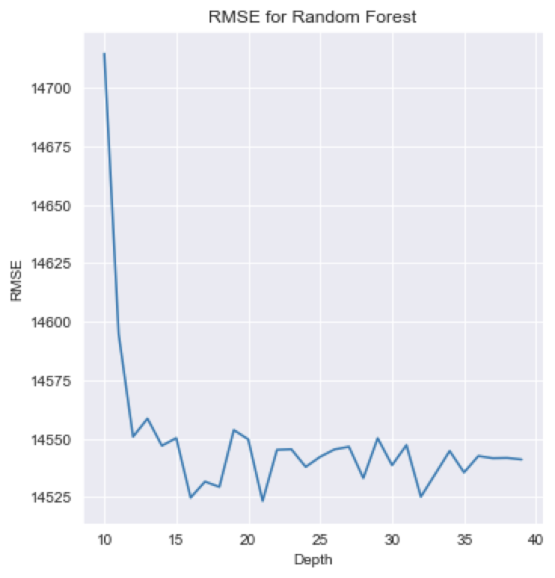
Random Forest
Best fit: depth = 21
RMSE_{fit} = 14543.179298
R^2_{fit}. = 0.980392
E(RMSE _{test}) = 17726.704161
E(R^2 _{test}) = 0.970781
Model Selections
REAL ESTATE LISTING
13–15

Slide 28
Report R^2 & RMSE
Model | Best λ | RMSE_{fit} | R^2_{fit} | E(RMSE _{test}) | E(R^2 _{test})
Linear | NA | 44817.903715 | 0.813782 | 44893.947386 | 0.812610
KNN | 6 | 16851.562677 | 0.973673 | 18601.933899 | 0.967749
Lasso | 1.6114143e-13 | 44817.903715 | 0.813782 | 44894.386830 | 0.812606
Ridge | 0.000671161 | 44893.861264 | 0.812610 | 44893.861264 | 0.812610
Decision Tree | 17 | 14386.833894 | 0.980811 | 17734.668799 | 0.970752
Random Forest | 21 | 14543.179298 | 0.980392 | 17726.704161 | 0.970781
Result Comparison
Best Worst

Slide 29
Report R^2 & RMSE (normalized)
Model | Best λ | RMSE_{fit} | R^2_{fit} | E(RMSE _{test}) | E(R^2 _{test})
Linear | NA | 0.204332 | 0.813782 | 0.204678 | 0.812610
KNN | 6 | 0.0768289 | 0.973673 | 0.0848091 | 0.967749
Lasso | 1.6114143e-13 | 0.204332 | 0.813782 | 0.204680 | 0.812606
Ridge | 0.000671161 | 0.204332 | 0.812610 | 0.204678 | 0.812610
Decision Tree | 17 | 0.0655917 | 0.980811 | 0.0808551 | 0.970752
Random Forest | 21 | 0.0663046 | 0.980392 | 0.0808188 | 0.970781
Result Comparison
RMSE(normalized) = RMSE / mean(y)

Slide 30
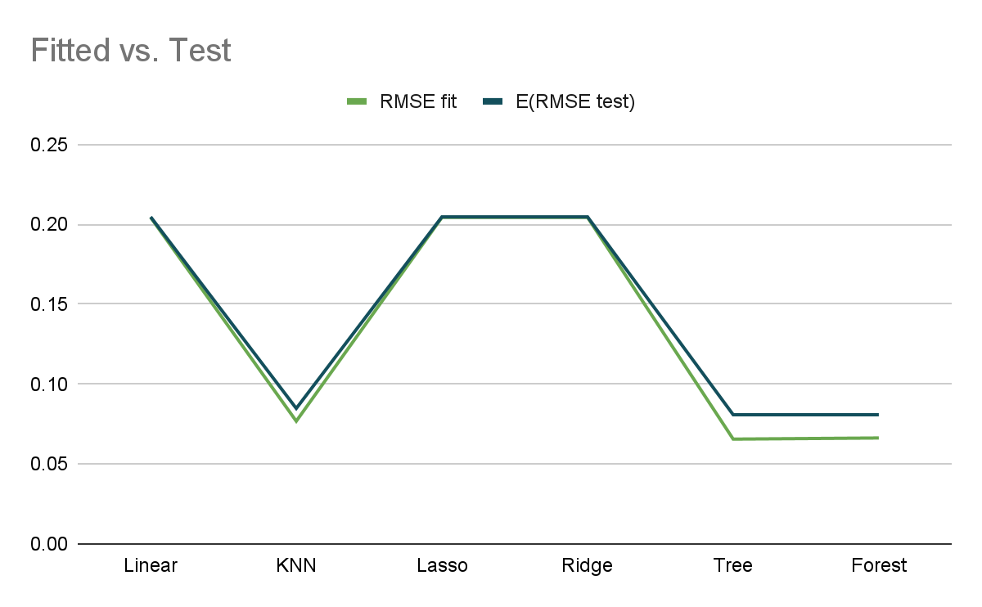
Result Comparison

Slide 31
Compare Fitted with Test
Model | RMSE_{fit} | E(RMSE _{test}) | Difference
Linear | 0.204332 | 0.204678 | 0.000346
KNN | 0.0768289 | 0.0848091 | 0.0079802
Lasso | 0.204332 | 0.204680 | 0.000348
Ridge | 0.204332 | 0.204678 | 0.000346
Decision Tree | 0.0655917 | 0.0808551 | 0.0152634
Random Forest | 0.0663046 | 0.0808188 | 0.0145142
Result Comparison

Slide 32

Thank you
for listening

